Slide 1
Edgar Chacón
Narine Fischer
Arnau Noguera
Aina Vaquer

Slide 2
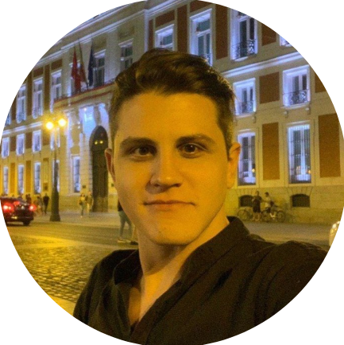
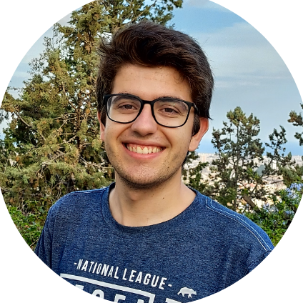
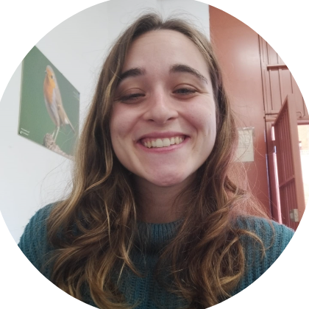
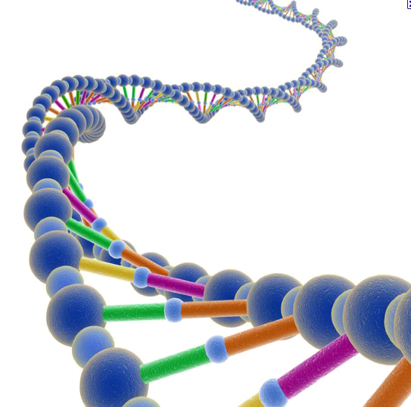
Our team
Problems
Edgar Chacón Narine Fischer
Biotechnologist Geneticist
Arnau Noguera Aina Vaquer
Geneticist Geneticist
Problem 1
Problem 2
Diagnosed patients have to undergo a process of acceptance, normally completely alone, with no one that understands what they are going through.
Professionals must get the correct diagnostic for a condition they might have never even listened about.

Slide 3
Objectives
Information from healthcare practitioners
Information for patients
Patient Associations
Patient experiences
Described mutations, symptomatology and possible tests for rare diseases
Symptomatology, form of heritability, possible treatments, medical professionals
Redirection to patient associations classified by country
First-hand accounts from patients

Slide 4
Objectives
Information from healthcare practitioners
Information for patients
Patient Associations
Patient experiences
Described mutations, symptomatology and possible tests for rare diseases
Symptomatology, form of inheritence, possible treatments, medical professionals
Redirection to patient associations classified by country
First-hand accounts from patients

Slide 5
Objectives
Information from healthcare practitioners
Information for patients
Patient Associations
Patient experiences
Described mutations, symptomatology and possible tests for rare diseases
Symptomatology, form of inheritence, possible treatments, medical professionals
Redirection to patient associations classified by country
First-hand accounts from patients

Slide 6
Objectives
Information from healthcare practitioners
Information for patients
Patient Associations
Patient experiences
Described mutations, symptomatology and possible tests for rare diseases
Symptomatology, form of inheritence, possible treatments, medical professionals
Redirection to patient associations classified by country
First-hand accounts from patients

Slide 7
Databases
Lysosome
Mucopolisacaridosis
We will use a mySQL database created by ourselves with information obtained from
MPS España
Orphanet
GeneReviews

Slide 8
Input
Search
Type
Hurler syndrome | Disease
 | Disease Gene Mutations

Slide 9
Output
Hurler’s Syndrome
Name: Hurler’s Syndrome or Mucopolisacaridosis type I
Gene: IDUA (4p16.3)
Protein: alpha-L-iduronidase enzyme
Inheritence: Autosomal, recessive
Prevalence: 1-9/1.000.000
Symptomatology: There is a delay of the motor and cognitive development, with muskuloskeletal alterations. The age of onset is 3-6 months after birth, however, there is an intermediate form in which the onset is in Adulthood (which presents normal stature and no intellectual deficit has been observed)…
Diagnostic method: Detection of an increase of heparan and dermatan sulfate in urine, detection of alpha-L-iduronidase enzyme in leukocytes, genetic testing
Treatment: Enzyme replacement treatment
…

