Slide 1
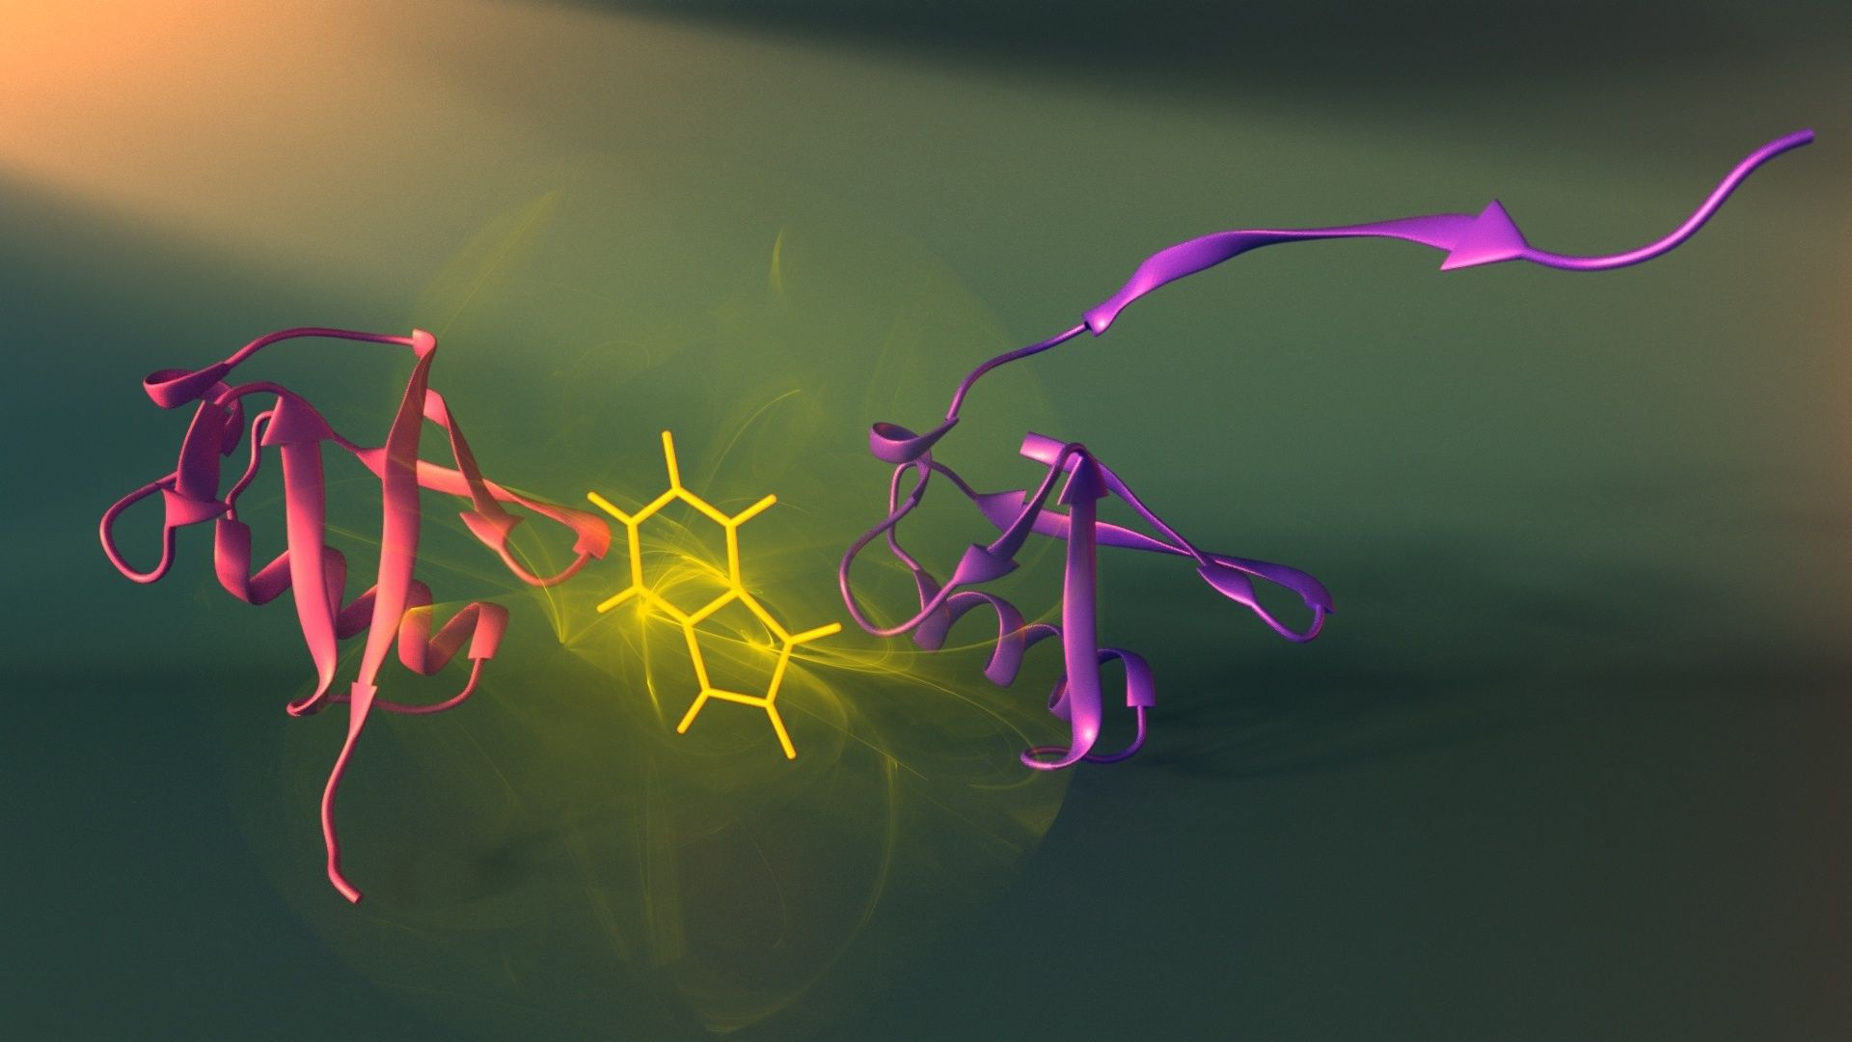
Bioinformatic analysis
OLIG2

Slide 2
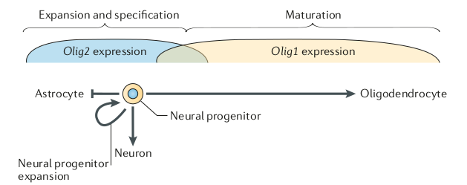

Slide 3
dN/dS applied to human OLIG2 paralogs

Slide 4
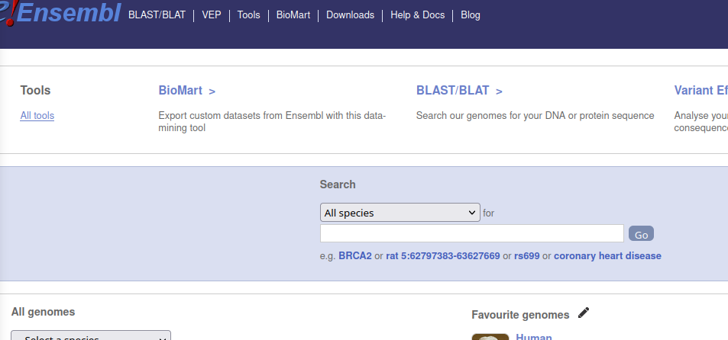
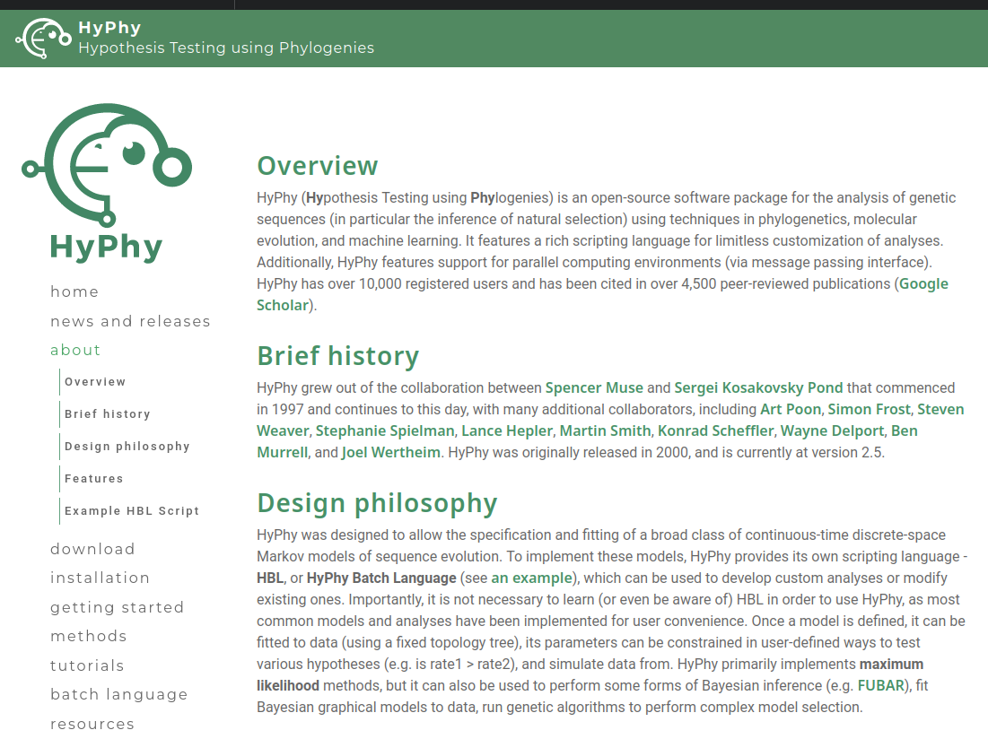
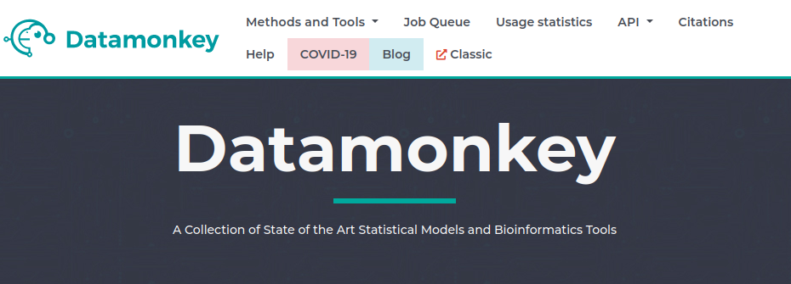
Methodology
A dataset of 16 OLIG2 paralogs genes were drawn from Ensembl database
Aligned and curated through Hyphy command line tool
Set was provided to Datamonkey for use of BUSTED and MEME

Slide 5
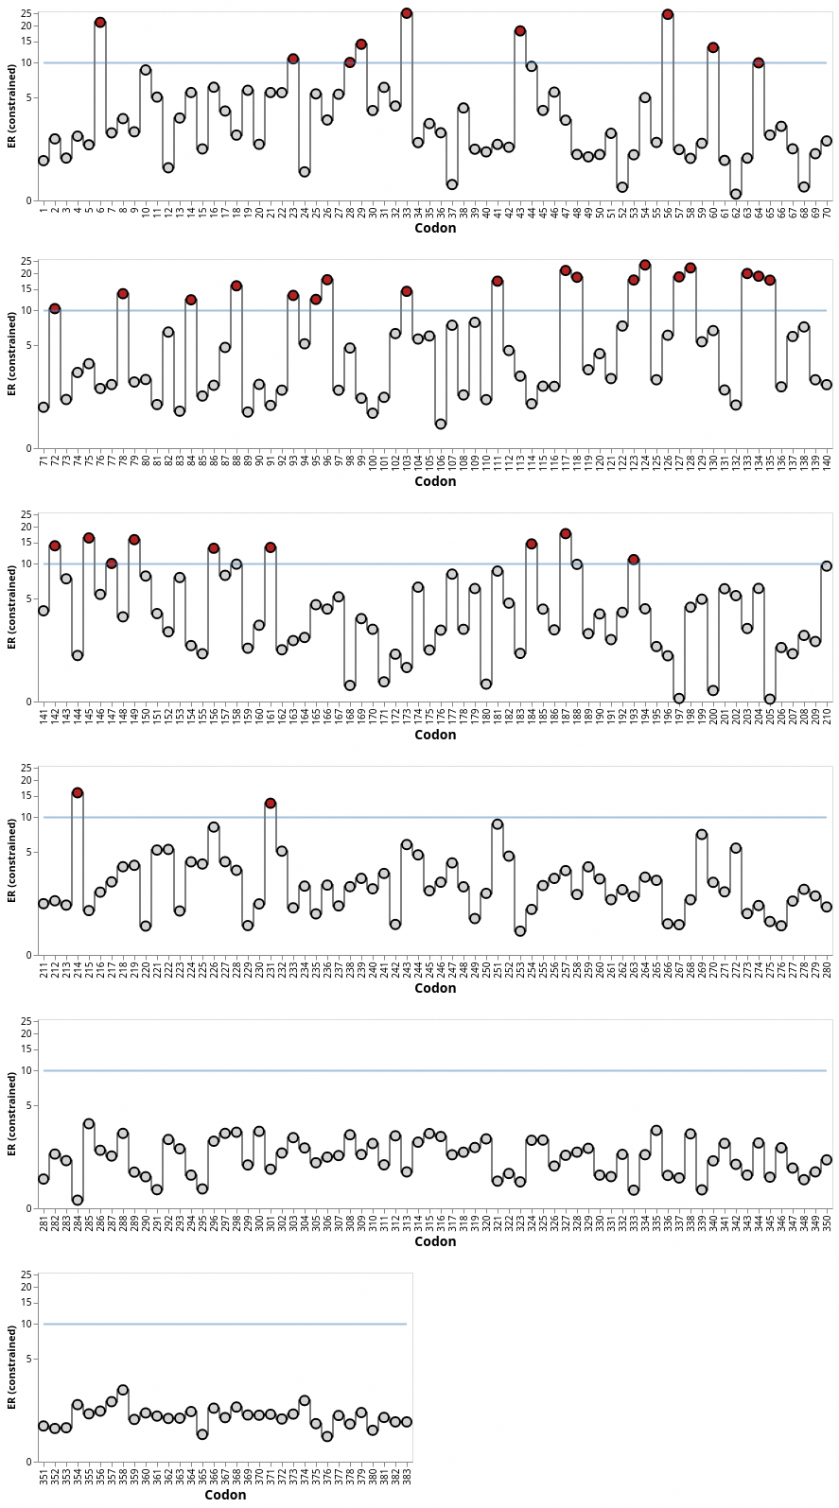
Results
BUSTED confirmed the presence of diversifying selection in at least one branch of the set (p=1.665e-16).
Then MEME was used to determine specific sites of positive diversification.
27 sites were found with higher LRT in comparison with the group (>4) and with p-value < 0.05.

Slide 6
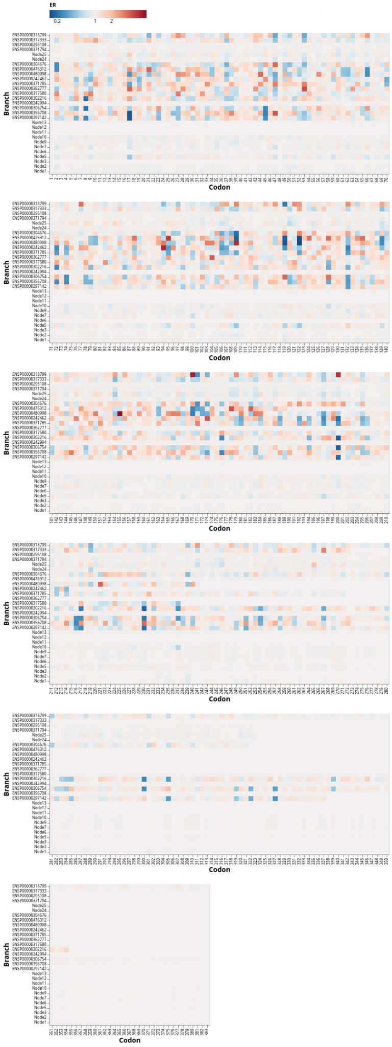

Slide 7
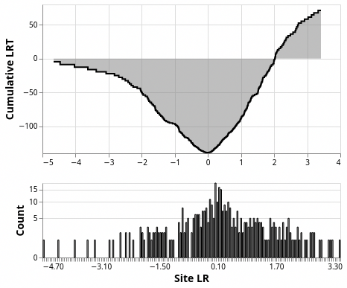
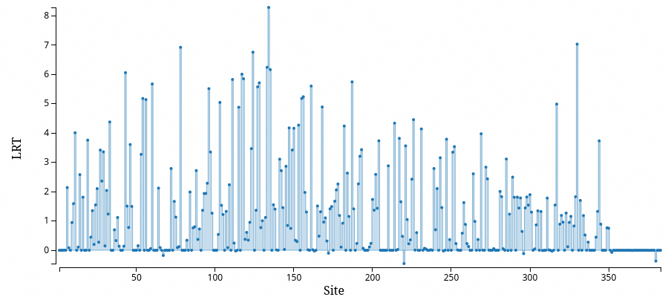

Slide 8
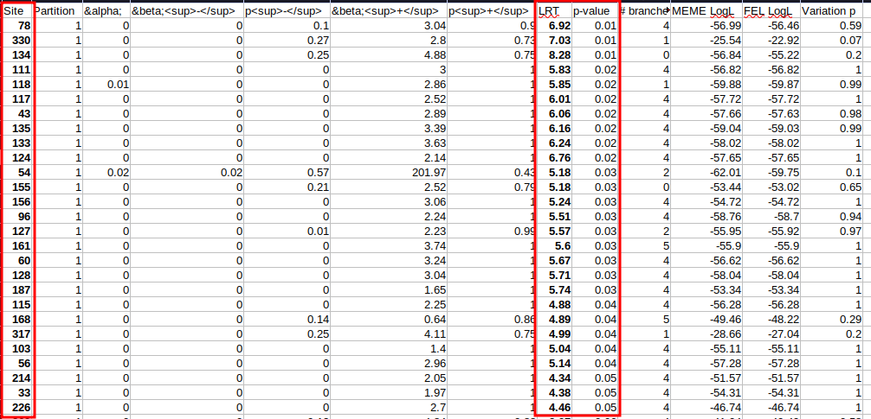

Slide 9
Conclusions
Within the context of human OLIG2 diversifying selection sites LRT > 4.46 among paralogs are of statistical significance.
27 sites of 383 were considered for positive diversifying selection (p-value > 0.05)
75% of the most diversifying selection sites are related to the BHLH motif super family, hinting evolutionary pressure in this motif.

Slide 10
RNA-seq analysis

Slide 11
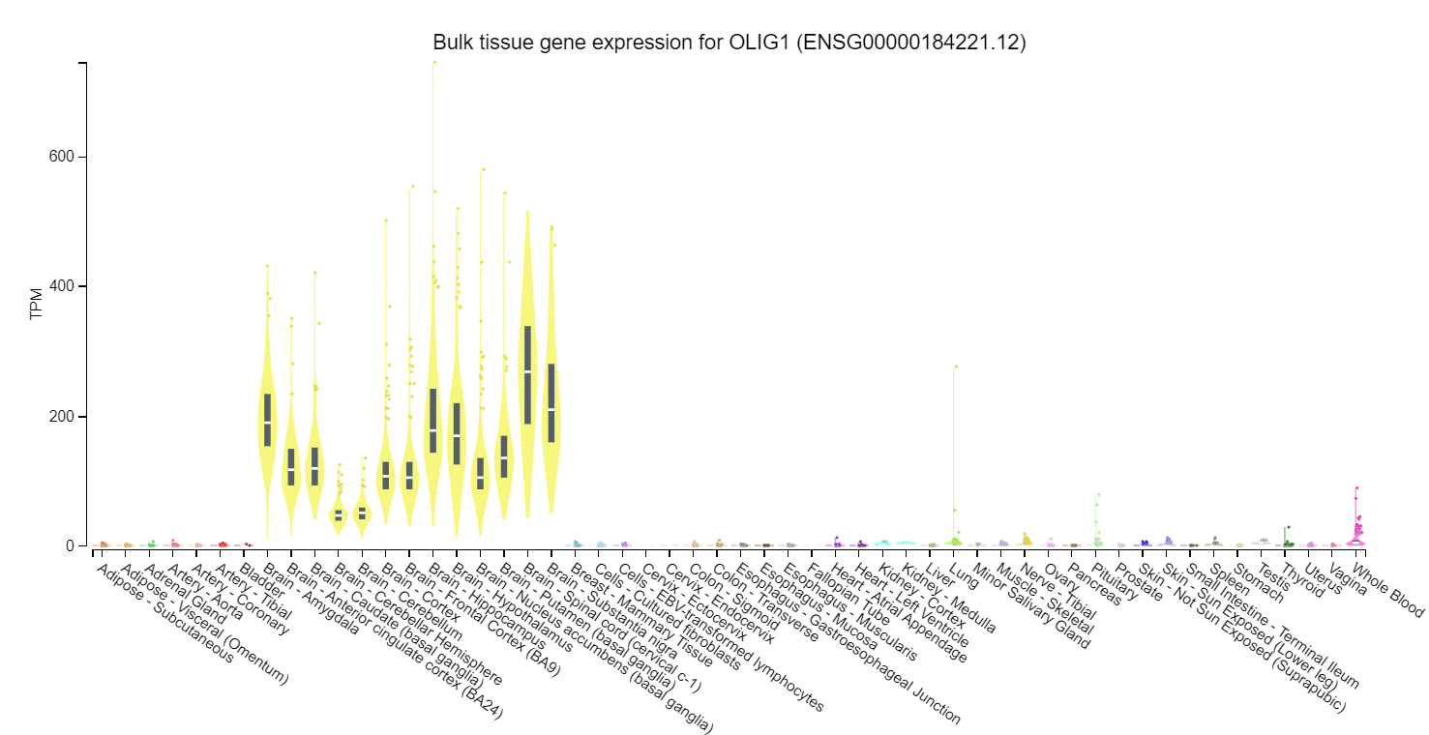
Bulk RNA-seq and tissue expression

Slide 12
Single-cell RNA-seq analysis

Slide 13
Autism-related expression data

Slide 14
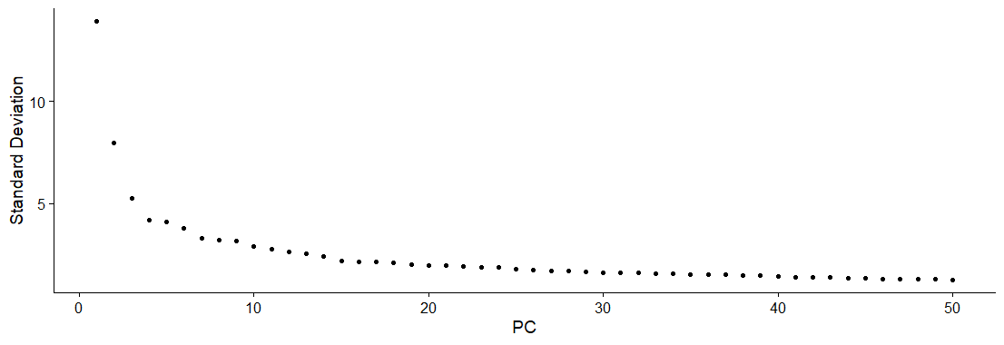
scRNA pre-processing
14 PCs selected as representative

Slide 15
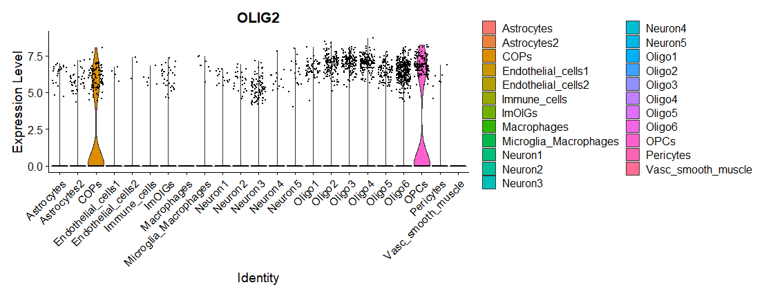
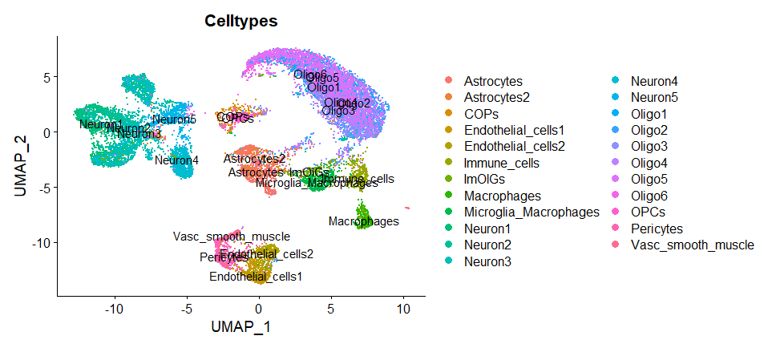
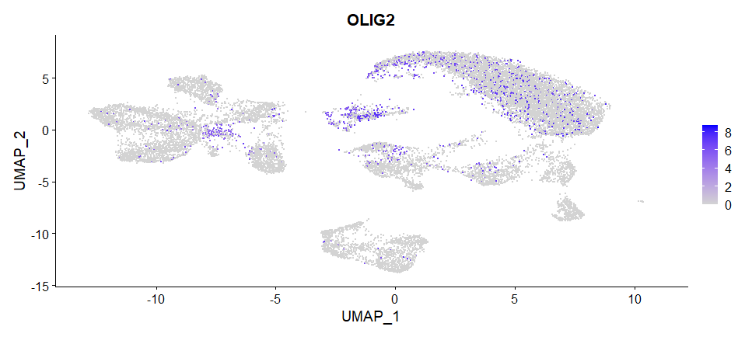
scRNA analysis
Most of the expression on OPCs and oligodendrocytes
Some expression in astroctyes and neurons
Few expression on immune cells

Slide 16
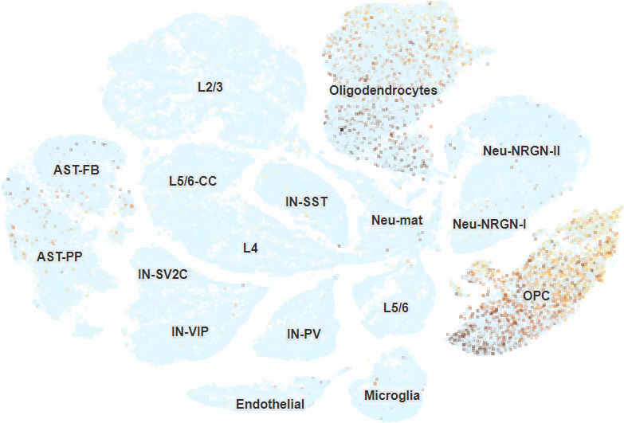
Velmeshev et al. (2019) results

Slide 17
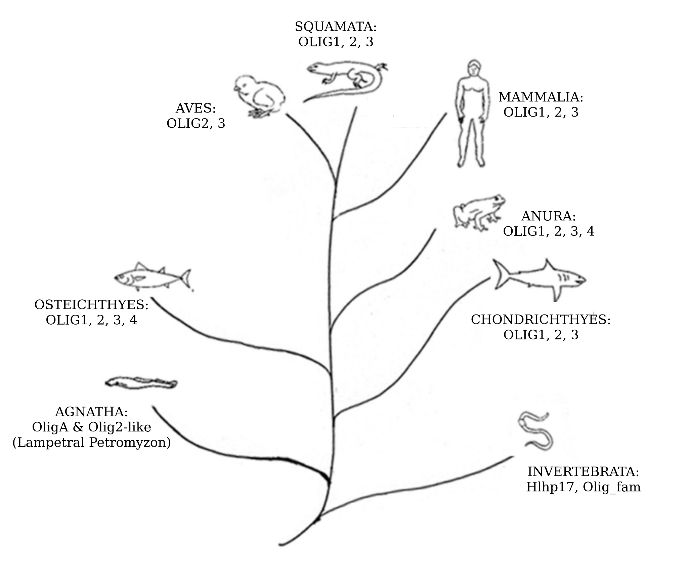
PHYLOGENY

Slide 19
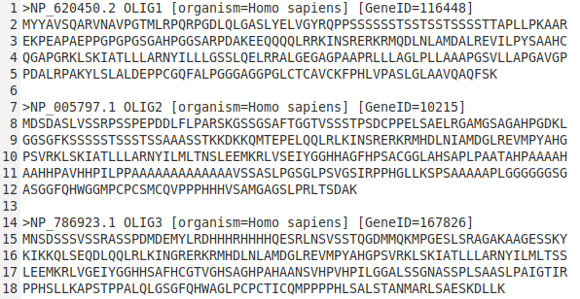

Slide 20
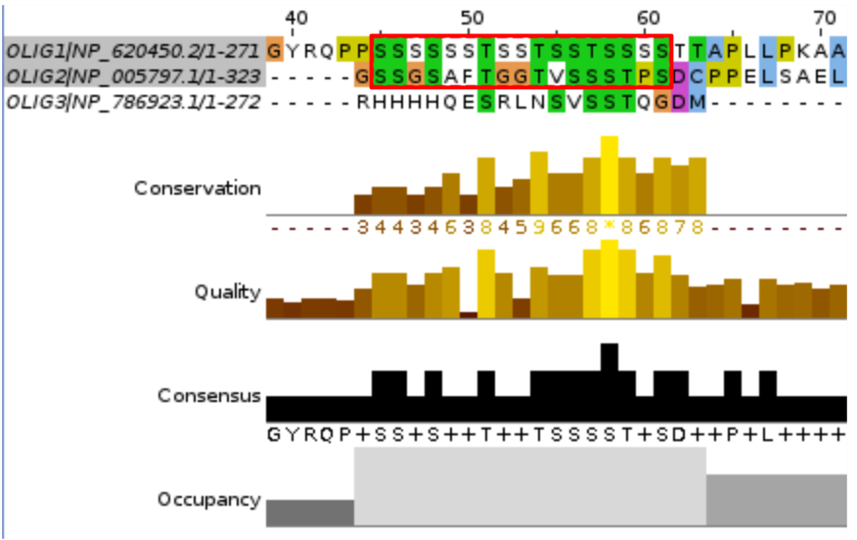
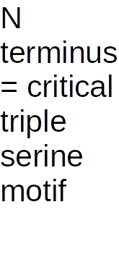

Slide 21
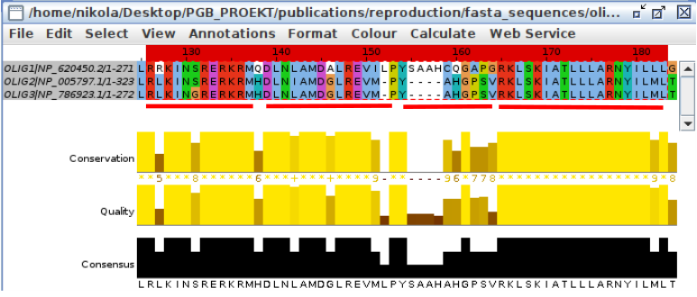

Slide 29
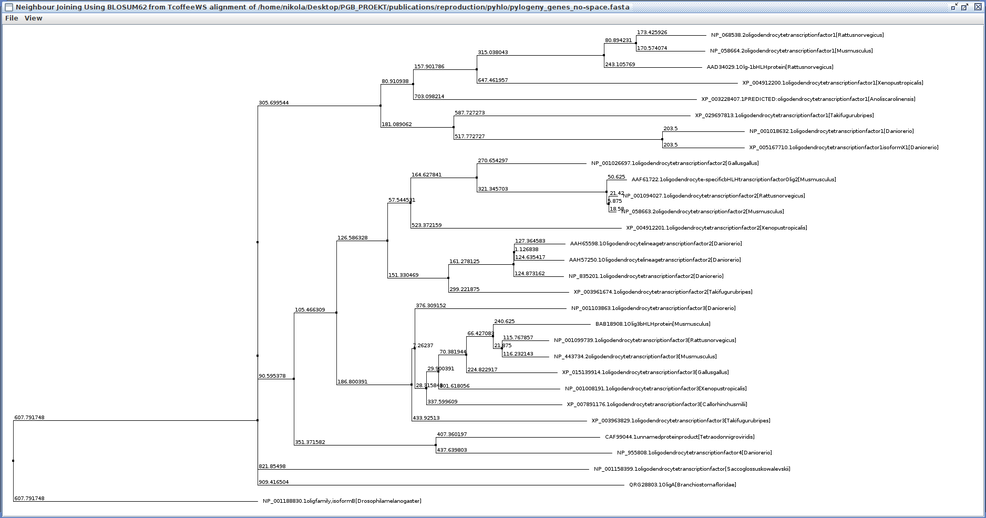

Slide 30
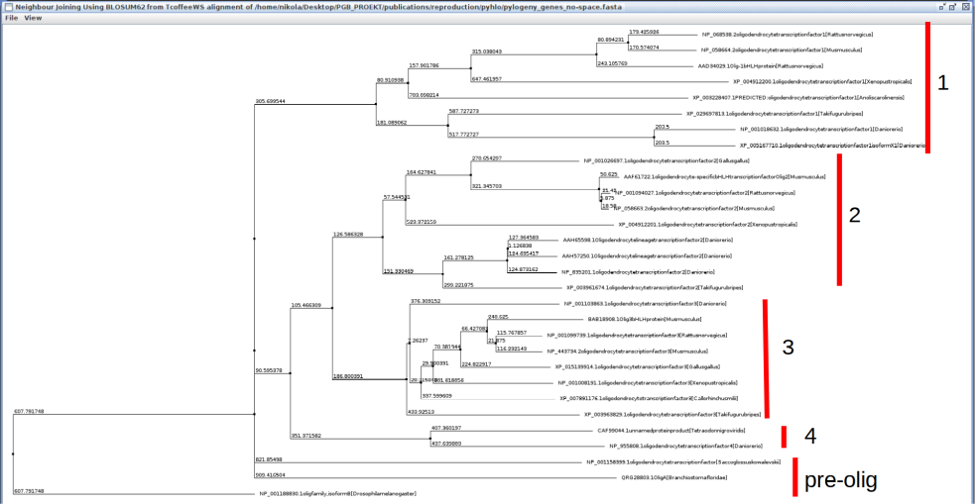

Slide 33
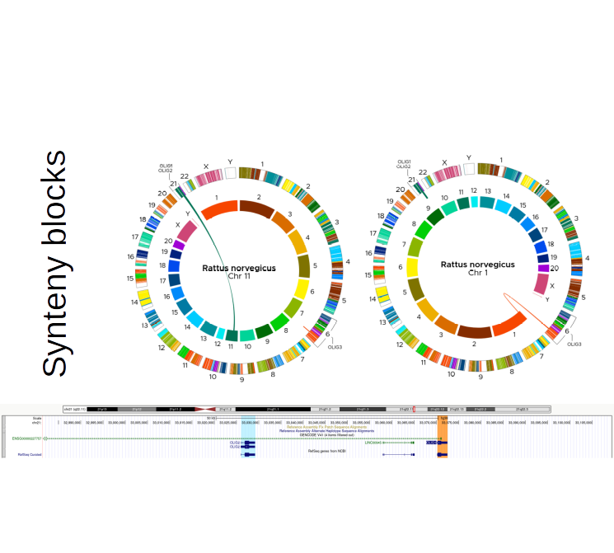

Slide 38
OLIG 2 ChIP-Seq ANALYSIS

Slide 41
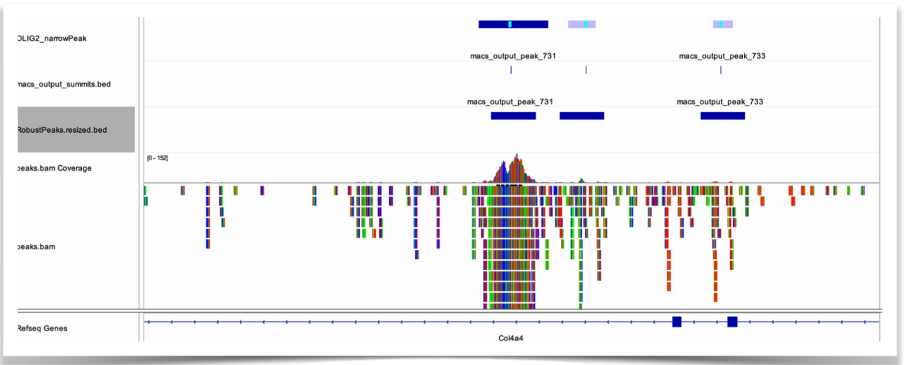

Slide 42
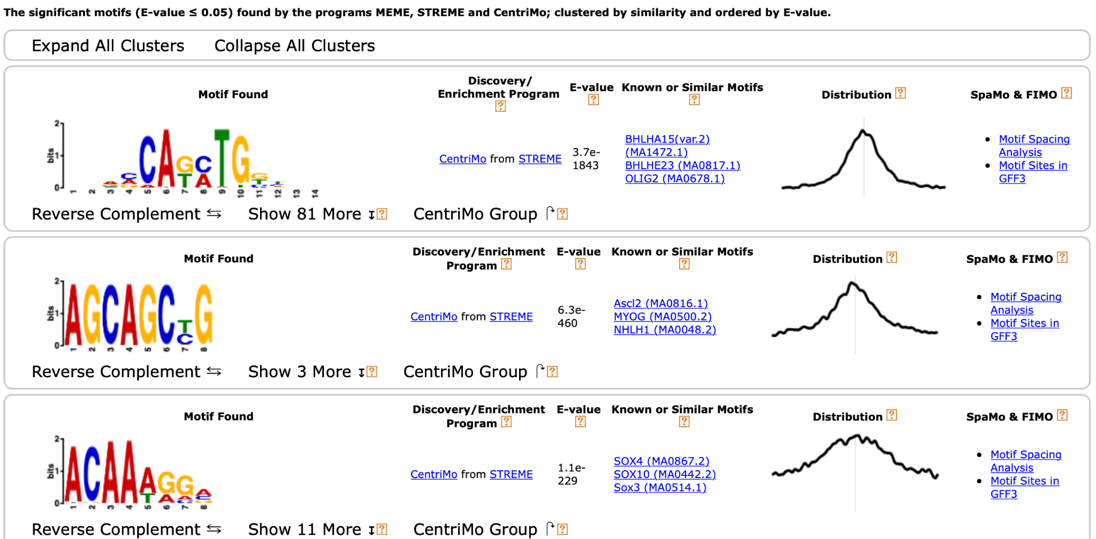

Slide 43
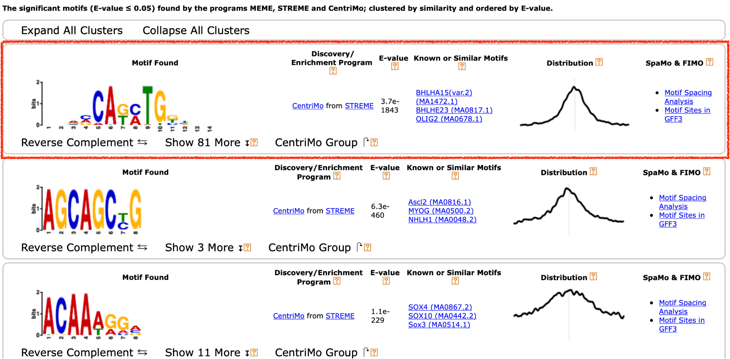

Slide 44
